Slide 1

Weekly demo
András Gerencsér • geriari • Week 04

Slide 2
What we learned this week
Object orientation
Inheritance
Abstract classes
Interfaces
Testing

Slide 3
What we learned this week
Object orientation
Inheritance
Abstract classes
Interfaces
Testing ♥

Slide 4
Count letters exercise
Function
Takes a string
Returns a dictionary (an Object)
key: letters of the string
value: number of letters in the string

Slide 5
Two things to solve
How to add a new key to an existing Object?
How to check if an Object’s key already exists?

Slide 6


Let’s turn to our best friends ♥

Slide 7
Adding a new key to an existing Object
let obj = {key1: value1};
obj.key2 = ‘value2’;
obj[‘key2’] = ‘value2’;

Slide 9
Checking if an Object’s key exists
if ('key' in myObj)
myObj.hasOwnProperty('key')

Slide 10
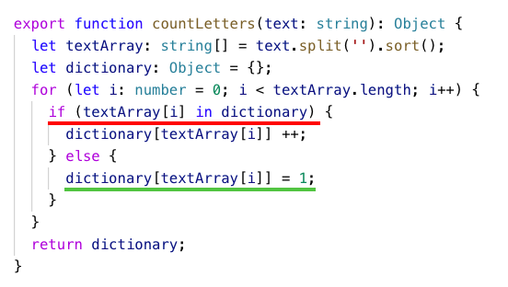

Slide 11
Try code with THM!
console.log(countLetters('friday finally'));
{ ' ': 1, a: 2, d: 1, f: 2, i: 2, l: 2, n: 1, r: 1, y: 2 }

Slide 12
Thank you
for your attention!

